Slide 1



Introduction to AI & Prompt Engineering
Dive into the dynamic world of Artificial Intelligence (AI) and the art of Prompt Engineering. Discover the importance, key concepts, and future scope of this transformative technology that is reshaping our digital landscape.
by Claire Rebecca

Slide 2
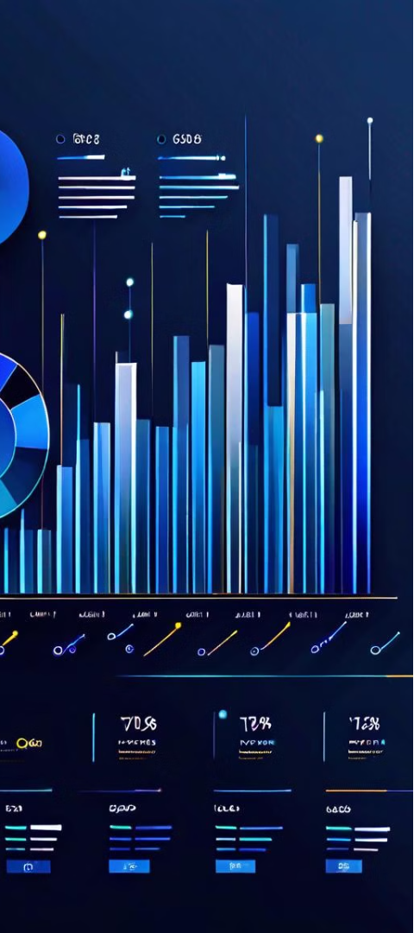
Importance & Applications of AI
1
Revolutionizing Industries
2
Enhancing Productivity
AI is driving innovation across sectors, from healthcare to finance, transforming how we approach complex problems.
AI-powered automation and decision-making tools are increasing efficiency and streamlining workflows.
3
Improving Lives
AI is being leveraged to address global challenges, from climate change to disease prevention.

Slide 3
Key Concepts in AI
Machine Learning
Natural Language Processing
Computer Vision
Algorithms that enable systems to learn and improve from data, without being explicitly programmed.
The field that enables computers to interpret and understand digital images and videos.
Techniques that allow computers to understand, interpret, and generate human language.

Slide 4

Fundamentals of Prompt Engineering
1
Define Objectives
Clearly articulate the desired outcome and purpose of the AI interaction.
2
Structure Prompts
Organize prompts in a logical, concise, and easy-to-understand format.
3
Refine and Iterate
Continuously test, evaluate, and refine prompts to optimize performance.

Slide 5
Techniques for Effective Prompting
Contextual Awareness
Logical Reasoning
Crafting prompts that consider the specific context and environment.
Incorporating step-by-step instructions and problem-solving strategies.
Emotional Intelligence
Iterative Refinement
Prompts that tap into human-centric elements like empathy and creativity.
Continuously testing and improving prompts based on feedback and results.

Slide 6




Prompt Design Best Practices
Clear Objectives
Structured Format
Measurable Results
Collaborative Development
Define the specific goals and desired outcomes.
Organize prompts in a logical, easy-to-follow manner.
Incorporate ways to gauge the effectiveness of prompts.
Leverage team input and diverse perspectives.

Slide 7




Integrating AI & Prompt Engineering
AI Adoption
Prompt Engineering
Continuous Optimization
Strategically integrate AI into existing workflows and processes.
Develop prompts that leverage the full potential of AI systems.
Refine and enhance the integration of AI and prompts over time.

Slide 8
Future Scope and Trends
Hyper-Personalization
Autonomous Systems
Ethical AI Development
AI-driven customization and tailored experiences for individual users.
AI-powered decision-making and self-learning capabilities in various applications.
Responsible and transparent AI practices to address societal concerns.

